Slide 1
Big Data Analytics For Weather Forecasting.
By Student Name
University Name

Slide 2
Project Aims
The aim of the project is to create 3 different classification techniques on our big data, perform the evaluation on these techniques and select the best technique. And that, given a set of meteorological measurements, the selected technique predicts which meteorological condition should occur.
The classification techniques implemented include;
- Logistic regression
- Random Forest
- Support Vector machine.
The evaluation metrics used are;
- RMSE (Root Mean Squared Error).
- MSE (Mean Squared Error).
- MAE (Mean Absolute Error).
- Classification/Prediction accuracy.

Slide 3
Project Objectives
To Perform Data preprocessing.
To Perform Feature Selection/Extraction/Dimensionality Reduction.
To implement Data visualization using various graphs including but not limited to:
- Correlation matrix.
- Confusion matrix as heat maps.
- Histograms.
- Accuracy plots etc.
Implement 3 different classification techniques.
Select the best classification technique

Slide 4
Project Hypothesis
The meteorological condition for pressure in the country Canada increases from the year 2012 to 2017.
The maximum humidity value attained between the year 2012 and 2017 is 70.0 for Israel.
The “sky is clear” weather condition was the most dominant condition that we could describe.
The year 2016 was the year with highest temperatures as one of the meteorological condition.

Slide 5
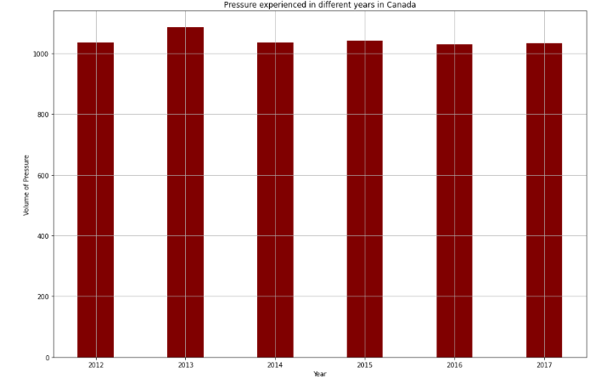
Results : Hypothesis 1
The meteorological condition for pressure in the country Canada increases from the year 2012 to 2017.
We reject the null hypothesis since the pressure at first increases from year 2012 up to year 2013, then reduces from year 2014 to 2017 at a constant value.

Slide 6
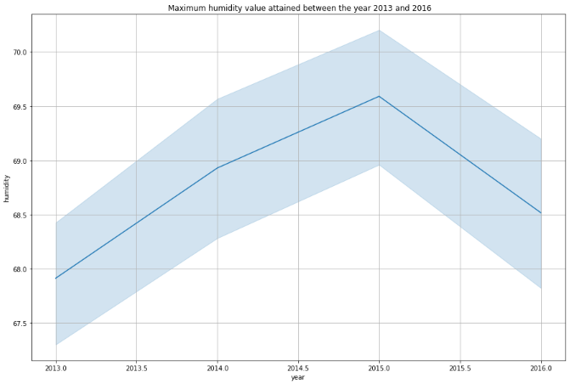
Results : Hypothesis 2
The maximum humidity value attained between the year 2012 and 2017 is 70.0 for Israel.
We reject the null hypothesis since the maximum pressure attained between the range of years between 2012 and 2017 is at 75.0

Slide 7
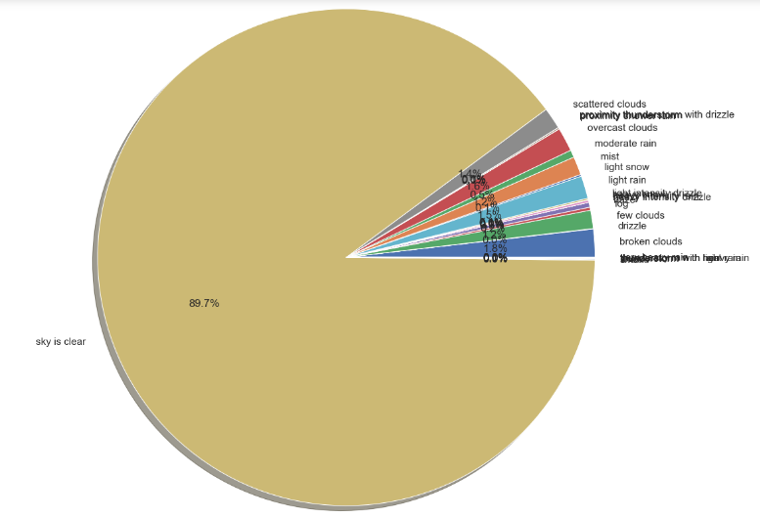
Results : Hypothesis 3
The “sky is clear” weather condition was the most dominant condition that we could describe.
We accept the null hypothesis since the most dominant weather condition in all the countries between year 2012 and 2017 was “sky is clear”.

Slide 8
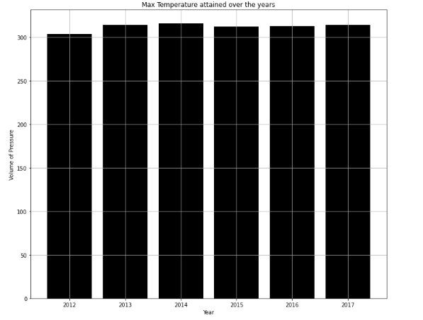
Results : Hypothesis 4
The year 2016 was the year with highest temperatures as one of the meteorological condition.
We reject the null hypothesis since highest temperature was experienced in the year 2014 in all the countries

Slide 9
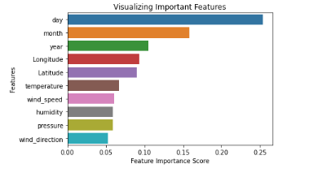
Feature Selection
The following is a visualization showing a important features selected to be used during classification technique implementation in order to improve the accuracy of our techniques.

Slide 10

Classification Techniques
We implemented the 3 classification techniques. We then performed evaluation on the 3 techniques, the following screenshots provided shows the MSE, MSR, RMSE and accuracy of each technique. Using these values we can comfortably select the best technique among the three.
SVM

Slide 11


CONT::
Logistic Regression
Random Forest

Slide 12
CONT::
Evaluation techniques | SVM classifier | Random Forest classifier | Logistic Regression classifier
MAE | 1.1168700324638978 | 1.175416993171387 | 1.1168700324638978
RMSE | 4.221147975047462 | 4.2899500904786425 | 4.221147975047462
MSR | 17.818090227247286 | 18.403671778797715 | 17.818090227247286
Accuracy | 0.9003694167692824 | 0.8937646927124147 | 0.9003694167692824

Slide 13
Conclusion
Thus, the overall we can interpret is that 42% of the SVM and Logistic predictions are correct and 43% of Random forest predictions are correct. For an ideal model, RMSE/MAE=0 and R2 score = 1. By checking our three techniques we worked on, its clear that none of the models worked better, to improve this, I propose in future research to work on other different classification techniques like Naïve Bayes Decision trees and many more. Model hyperparameter tuning is also an alternative to improve the model performance. However, due to large dataset, I spent more time on cleaning the data.
However, from what we have, both SVM and logistic regression technique comes the best. In future, I propose to work on a more balanced dataset in order to have better results.

